Slide 1
Shell Bootcamp 2024 Reflections for Week 1
Tanisha Verma
Date : 30-Aug-2024

Slide 2

About Me
I am a motivated and organized individual who likes to learn new things in life. According to me, learning has no age bar. I believe in teamwork.

Slide 3

My learnings from this week!

Slide 4

Learning 1 (DAY 1 – Soft skills Bootcamp) | My takeaways
I learnt 10 qualities and behaviors of professional people.
I discovered different type of people working in a team through CART model. I recognized myself as an initiator through an activity .
I learnt the difference between growth mindset and fixed mindset. Only growth mindset can help us achieve success in life.
E-email etiquette was taught which is necessary for sending emails to the clients and other team members in a proper format.
Teamwork Activity

Slide 5
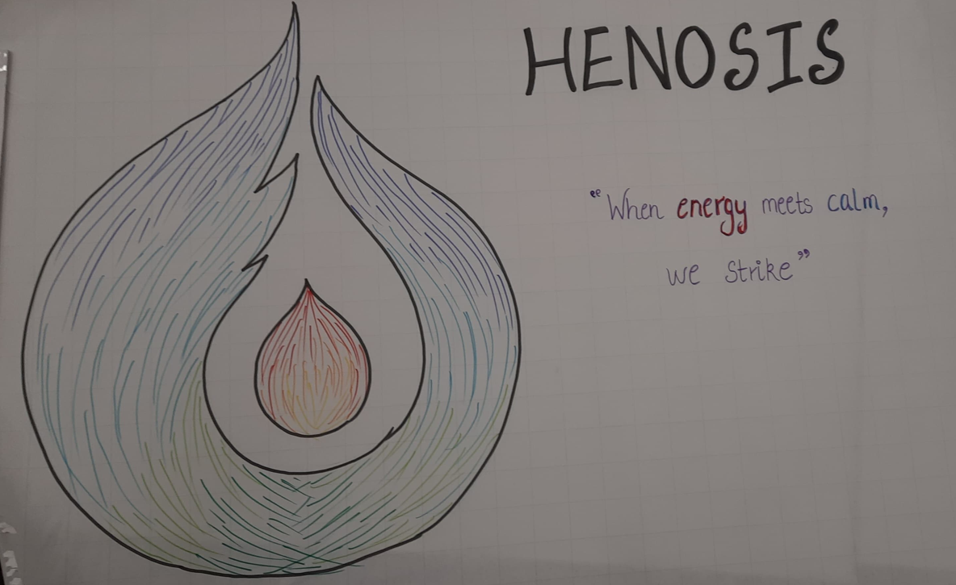
Learning 2 (DAY 2 – Soft skills Bootcamp) ) | My takeaways
I learnt Stakeholder Management in detail.
Stakeholder Management includes Identifying stakeholders, planning stakeholder management, stakeholder engagement and Controlling Stakeholder Engagement.
Got to know more about Shell’s Trust model.
Learnt about meeting etiquette.

Slide 6
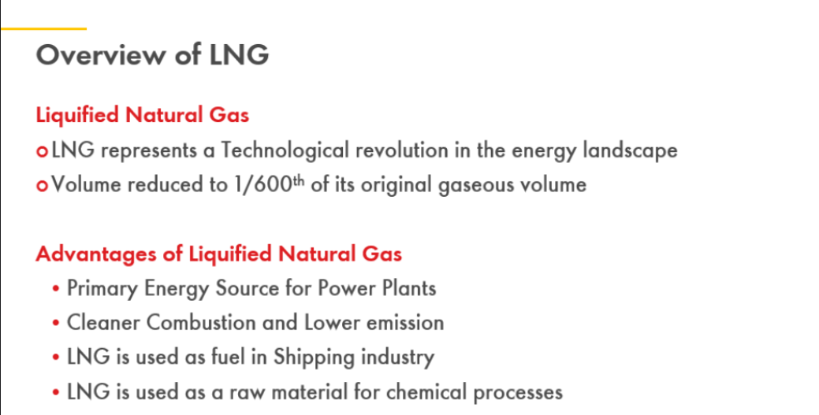
Learning 3 (DAY 3 – Soft skills Bootcamp) ) | My takeaways
I learnt about different stages of team development like Forming, Storming, Reforming and Norming.
I learnt about Presentation skills which will help to interact with the clients and team members in a better way.
We were divided into teams and prepared an informative presentation on ‘LNG”

Slide 7
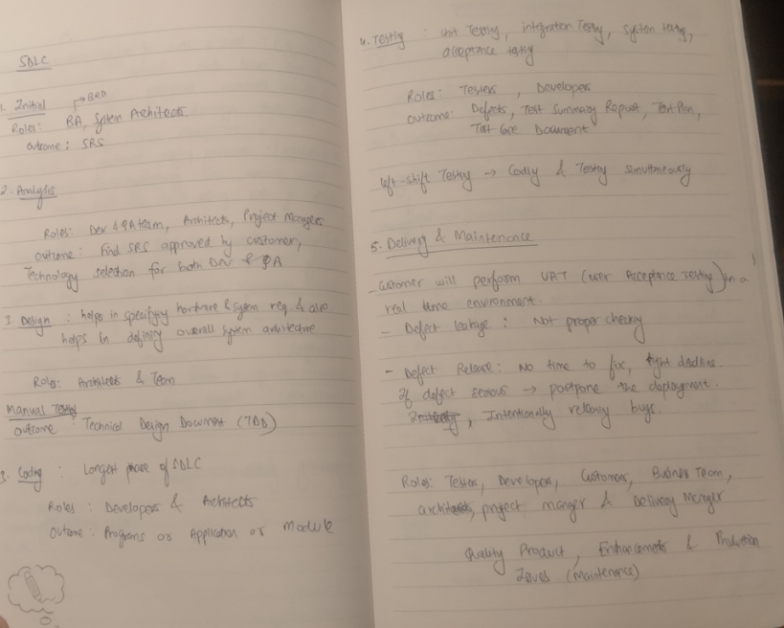
Learning 4 (DAY 4 – Foundational Technical Bootcamp) | My takeaways
The first day of Technical bootcamp was about Business Analytics and Agile.
Learnt about the work done by business analyst in detail.
Requirement Elicitation was the most important concepts learned along with critical aspects of Project Management.
Software Development life cycle was very important as it will be used in every project which will be assigned to me.

Slide 8
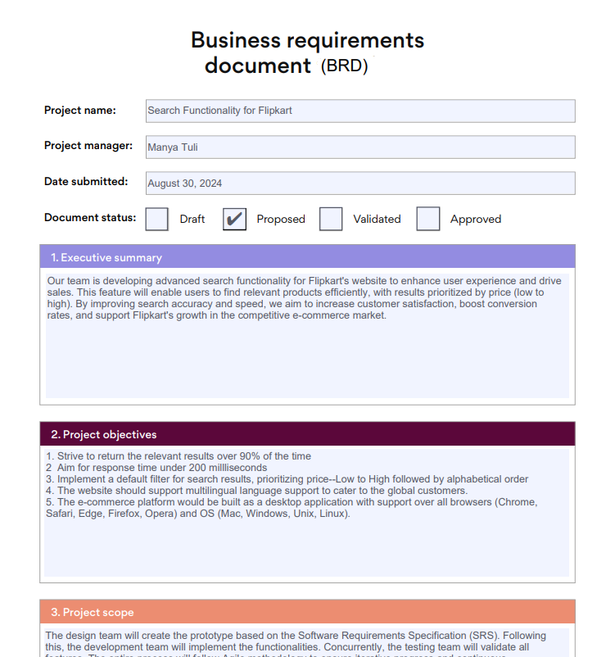
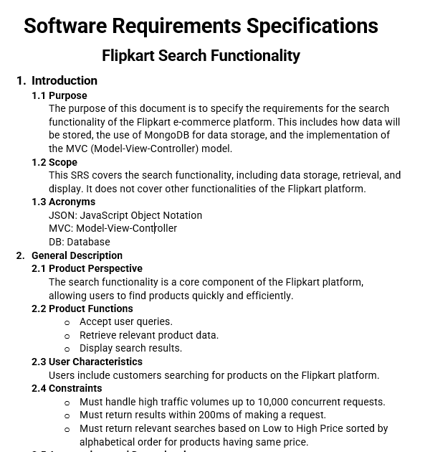
Learning 5 (DAY 5 – Foundational Bootcamp) | My takeaways
The second day of Technical bootcamp was about Business Analytics and Agile.
I learnt about different types of SDLC models like Waterfall model, V-type, Prototype and Agile model.
In-depth discussion of Agile model was done.
We were divided into teams and given a case study to prepare BRD (Business Requirement Document) and SRS document.

Slide 9

Relevance of learnings for my organization

Slide 10
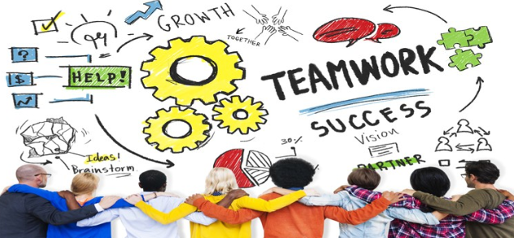
Learning 1 | Relevance for Shell
Our company has project teams which may consist of different types of team members such as Performer, Highly Effective Doer, less effective doer and initiator etc. This will help to manage people well and understand the team member’s strength areas.
Growth mindset and email etiquette will help the company increase its employee’s work efficiency.

Slide 11

Learning 2 and 3 | Relevance for Shell
Meeting etiquette is the one thing which is considered important for an employee as they will spend most of their time in meetings with the clients and other team members.
Shell educates its employees about Shell’s trust model, meeting etiquette, presentation etiquette and Stakeholder Management which will help employees to perform better in the workplace.

Slide 12
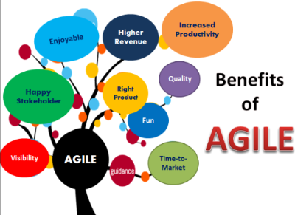
Learning 4 and 5 | Relevance for Shell
Our company implements this learning by educating its employees about Agile model which is the most used Software Development Life Cycle model.
This will make freshers ready for having business as well technical skills and mindset ready which are the key to perform well in projects.

Slide 13

Challenges in implementing learning

Slide 14

Challenge faced while implementing Learning 1, 2 and 3
Challenge: I had a mix of both growth and fixed mindset which was identified after the interaction with the trainer.
I overcame this by studying about the benefits of having a growth mindset in the workplace. This learning changed my perspective and now I believe in having a growth mindset.

Slide 15
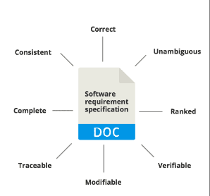
Challenge faced while implementing Learning 4 and 5
Challenge: The SRS document prepared by the team did not include some other details which were to be included in that document.
Studied and got feedback from the trainer about the details to be included. Edited the document to include the details.

Slide 16

Action Plan

Slide 17
My Action Plan for this Week
Actions
Timeline
Status
In the next week I will be learning DevOPs and do some practical implementation on theoretical topics.
Next week
Expected to get practical knowledge and skills and be project ready.

Slide 18

Learning is also Fun!

Slide 19

Learning is also Fun!
We were working in a team activity to learn Teamwork in which we were asked to write a minimum six letter word on a sheet of paper. It was to be done by a single pen with 4 strings tied to the pen and each end was operated by one of the four team members positioned in north, south, east and west directions. The fun and teamwork directing each other in which direction to move was enjoyable.

Slide 20

Summary
Quick summary
Key learnings from soft skills bootcamp were to manage relationships well, open lines of our communication and manage conflicts and expectations well.
Key learnings from 2 days of foundational bootcamp were we got an idea of how business analyst works, the project team structure and basics of Agile.
Importance of topics of upcoming week
For the upcoming week foundational bootcamp will have some informative and good topics planned which will make me project ready.
Connectivity of topics from current week
The Agile topic will continue, and we will get some more hands-on activity to perform.

Slide 21
Thank You

